Slide 1
CaPool
http://capool.azurewebsites.net/
Shared Travel, Simplified

Slide 2
Cloud Deployment
Microsoft Azure
http://capool.azurewebsites.net/

Slide 3
Interface
1. UI & UX
Colour Scheme Consistency
Contrast
Layout Common Conventions
2. Accessibility & Responsiveness

Slide 4
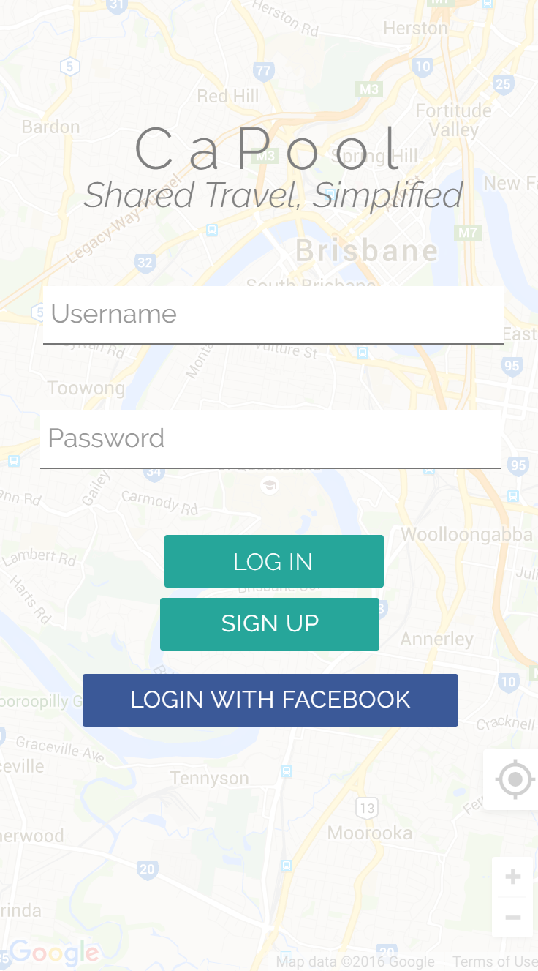
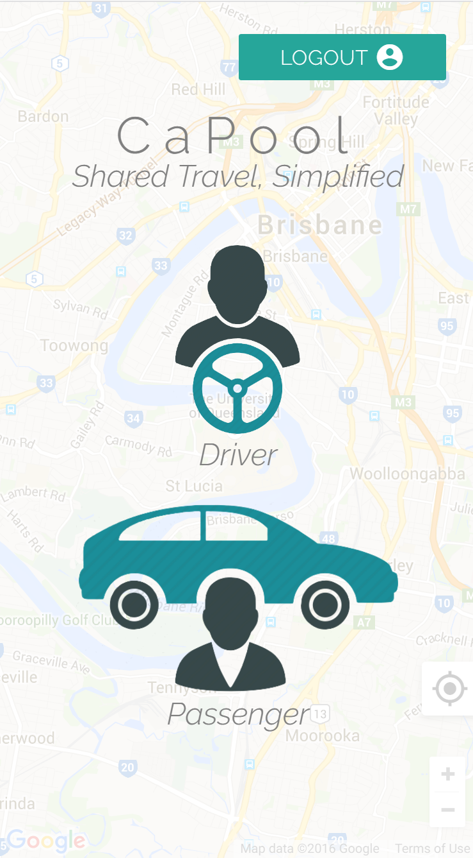

1. UI/UX: Colour Scheme
The website primarily uses a colour scheme consisting of five main colours:
Black
Grey
Blue
Teal
White

Slide 5
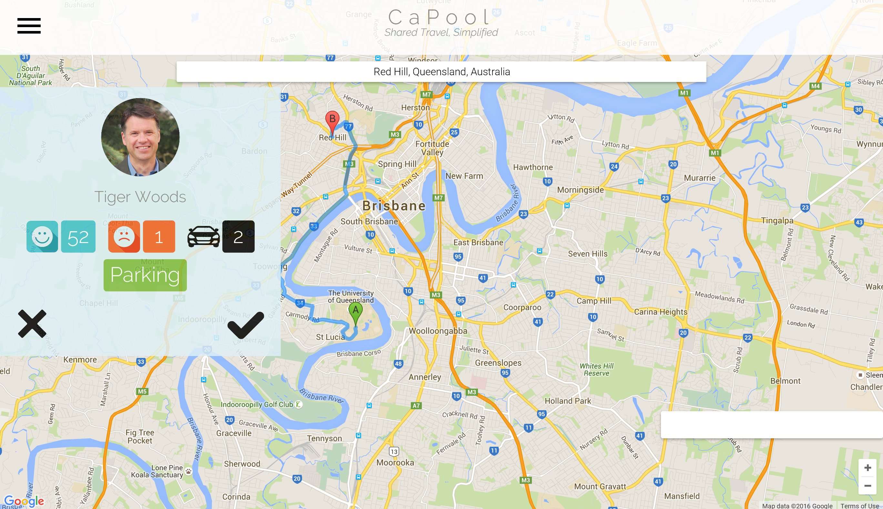
1. UI/UX: Contrast
Whenever important text was to be displayed to, or entered by the user, one of two options was used:
White text for darker/colourful backgrounds
Black/grey text on white backgrounds
2.
1.
3.

Slide 6
1. UI/UX: Layout Common Conventions
1.
2.
3.
4.
Locate Me
Menu – left-hand side
Heading Bar with Logo – links to homepage, middle top of page
Search Bar – close to top of page
Locate Me Button – bottom right hand corner

Slide 7
2. Accessibility
ALT Tags
Description of images for screen readers
HTML5 Semantic Elements
Nav & Heading
Aside
Search
2A.
2C.
2B.
1.
Locate Me

Slide 8
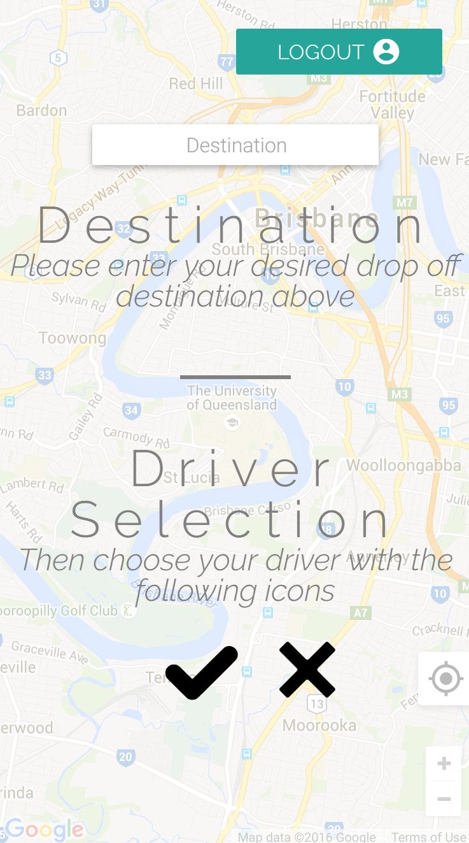
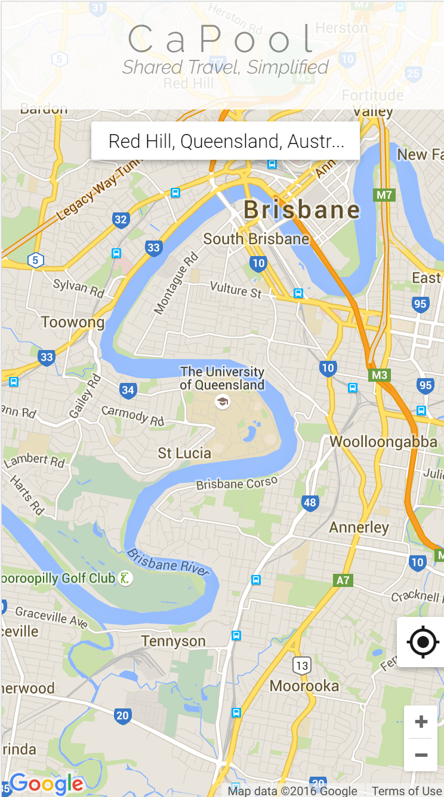
2. Responsiveness
iPhone 6:
375 x 667px (later doubled)

Slide 9
Functionality
Advanced JavaScript
Server Side Language
Database

Slide 10
1. Advanced JavaScript
Client Server Communication with JavaScript
Background location tracking
Obtains users Geolocation every 5 seconds, sends it to a PHP file along with the user's unique ID via JavaScript, which then adds the data to the database, either through an INSERT or UPDATE action
Data Exchange Format: JSON
We did not find JSON necessary as it is a non-extensible language
JSON has no validating tool
Not needed as we are not processing large amount of data at this time
Using a intermittent language would add unneeded complexity

Slide 11
1. Advanced JavaScript
External Libraries and/or API’s
HTML5 standard API – Geolocation API
jQuery
Google Maps API
Minimise library – login/sign up forms
JavaScript Proposal
Distance and time from user to drivers route
Data not obtainable from Google (for privacy)
Replaced with FB login detection and photo display

Slide 12
2. Server Side Language
Use of PHP
Sign up
Sign In
Logout
Session Control
Facebook Detection, and Login
Features from Proposal
Sign in, up and logout
Cycling through passengers/drivers

Slide 13
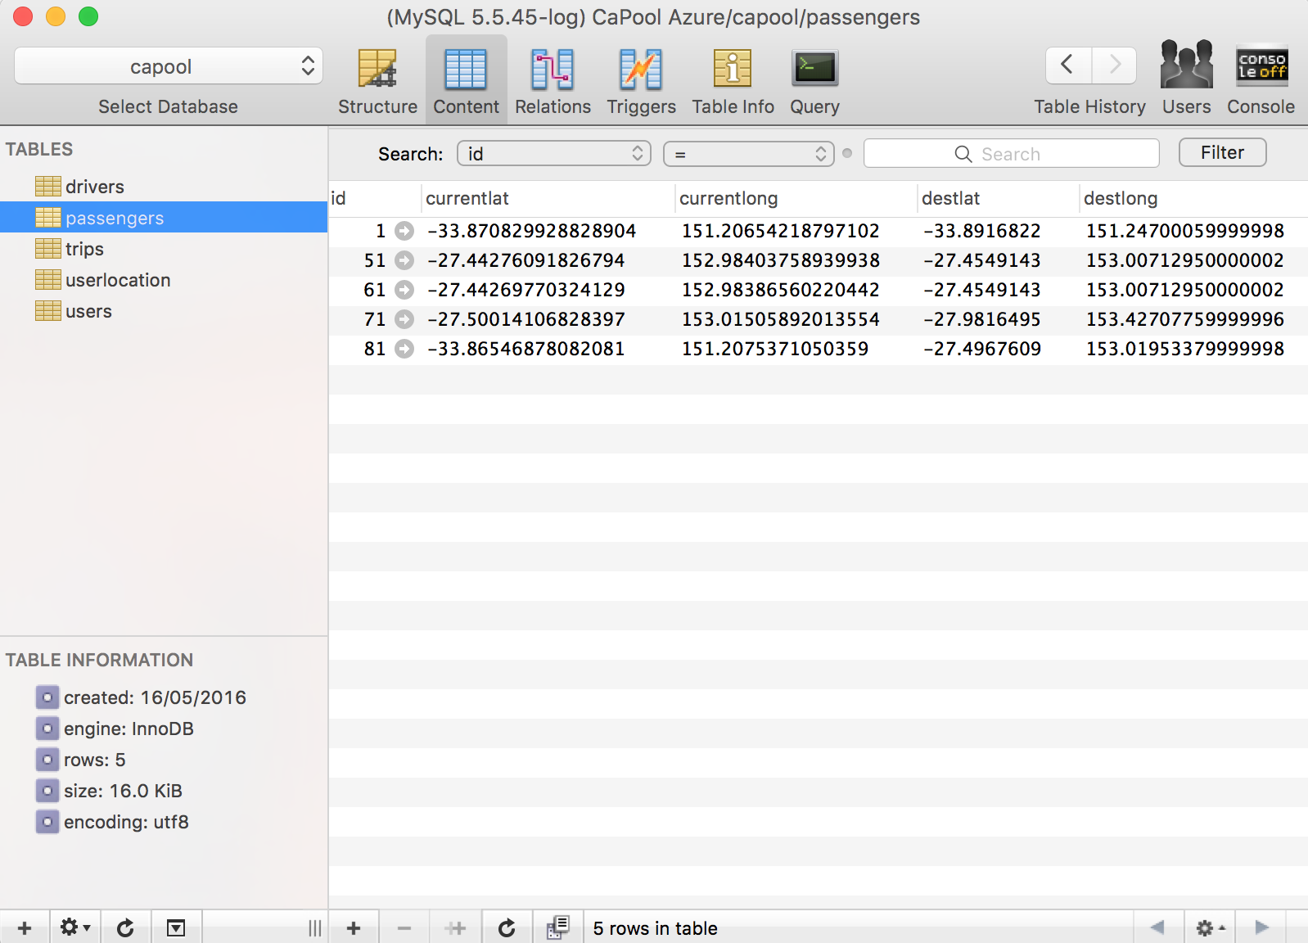
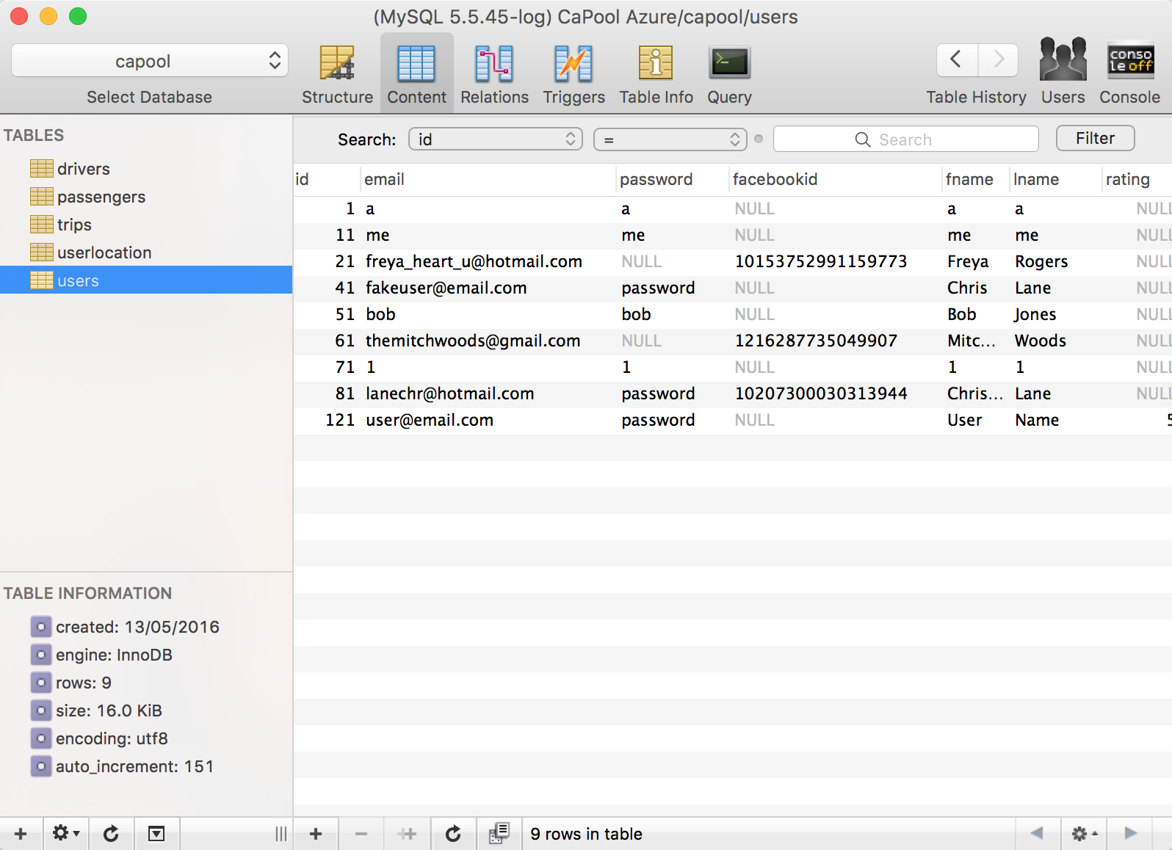
3. Database
Appropriate DB
Five different tables
Communication with DB
Email, password and FB id used for login. FB id used for login and photo.

Slide 14
Security
DoS Attacks
OWASP Top 10

Slide 15
1. What is a DoS?
DoS: Denial of Service Attack
It’s a malicious attempt to deny access for the legitimate users of a service
An attacker uses varying amounts of non-trivial computing resources to send excess traffic to a site
Causing the site to stop loading due to not being able to keep up with the number of concurrent (fake) users

Slide 16
1. DoS Attack Prevention
Azure has built-in load balancers that starve off DOS type Attacks
Uses standard detection and mitigation techniques such as SYN cookies, rate limiting, and connection limits.
As the application is hosted in the cloud there is the advantage of auto-scaling when attacks occur, so the site is less likely to crash.
Other practices taken:
Frequent monitoring of traffic and database for any suspicious activity

Slide 17
2. OWASP Top 10
Injection
Broken Authentication and Session Management
Cross-Site Scripting (XSS)
Insecure Direct Object References
Security Misconfigurations
Sensitive Data Exposure
Missing Function Level Access Control
Cross-Site Request Forgery (CSRF)
Using Components with Known Vulnerabilities
Unvalidated Redirects and Forwards

Slide 18
2. OWASP Top 10
Broken Authentication and Session Management
Login exploration – logout button and login expiry at the end of each session
Security Misconfiguration
Custom Code and frequent monitoring of suspicious activity
Sensitive Data Exposure
Azure Protects the website by providing a cloud based platform
Missing Function Level Access Control
To protect against this asks for a security company to be employed to protect our system

Slide 19
2. OWASP Top 10
Cross Site Request Forgery (CSRF Or XSRF)
Being aware of the what the scammers usually ask to access the system – keep important access usernames and passwords confidential
Using Components with known Vulnerabilities
Keeping data libraries up-to-date and current
Invalidated Redirect & Forwards
Keeping usernames and password secure and confidential

Slide 20
2. Extra Security
Confidentiality
Integrity
Monitoring of code/messages
Authentication
Verify the identity by Facebook login and monitoring
Non-Repudiation
Ensuring that integrity and authentication are upheld
HTTPS
Not implemented as SSL have to be purchased, tutor advised against this
SSL Certificate
Binds together domain name, with organizational identity (i.e. name) and location.

Slide 21
Cloud Deployment
Microsoft Azure
http://capool.azurewebsites.net/

